Slide 1
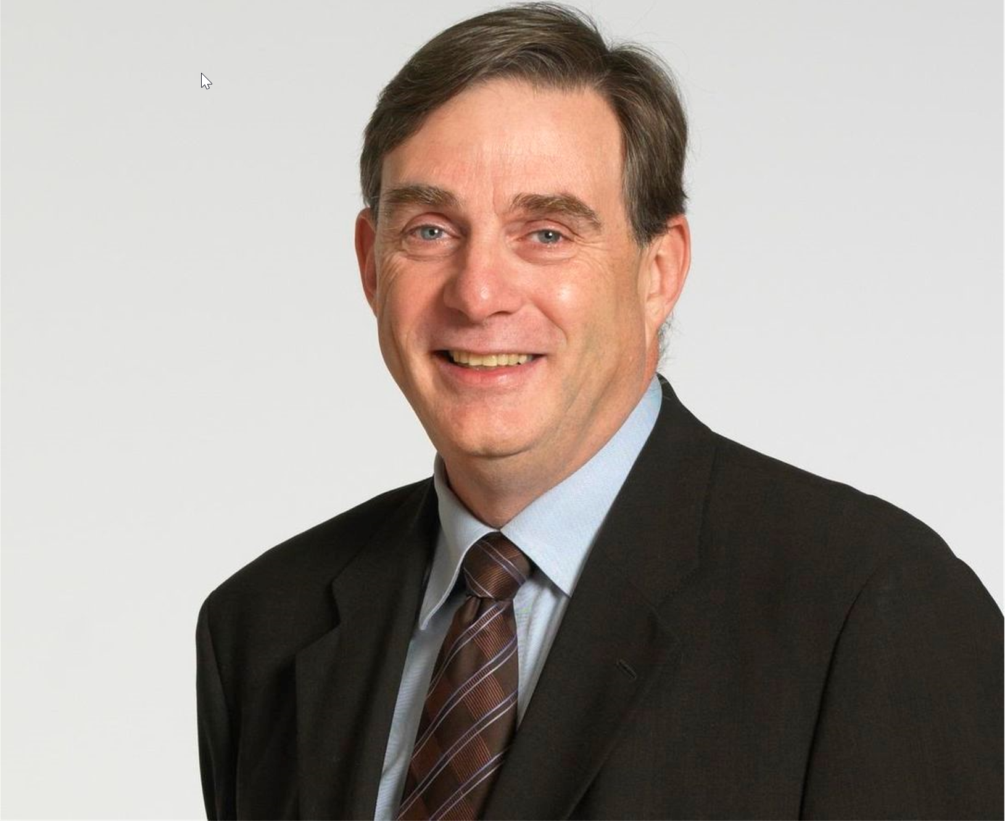
Learning to LEAD SESSION
Tuesday, July 17, 2021 – 10:30 am to 12:30 pm EST
Learning to LEAD – Saturday, July 17, 2021
Mr. Howard Bogach, Coach and Consultant
CEO of 3 multi million-dollar organizations for over 25 years
Former Vice president of human resources
Coach and consultant
Insolvency practitioner
Register here or through the Android or Apple Mobile App of ICAI Toronto Like and Follow us on Facebook and LinkedIn

